Slide 1
Angular
Angular Modules
Lecture 7
By James(Jin) Wang
09/01/2019

Slide 2
Outline
Routed Modules
Eager Loading
Lazy Loading
Preload Strategies
Feature Modules
Providers

Slide 3
Routed Modules
  Angular Modules:
  Help organize our applications into cohesive blocks of functionality

Slide 4
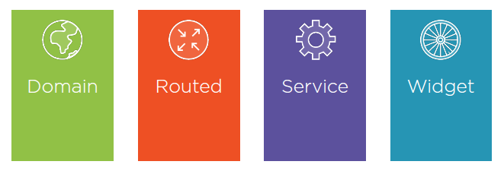
Routed Modules
  Basic Types of Feature Modules:

Slide 5
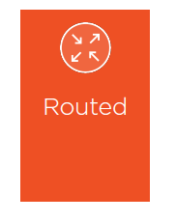
Routed Modules
  Routed Modules Are Eagerly or Lazily Loaded:

Slide 6
Routed Modules
  Eager Loading:
  Loading a feature module at startup, with the root module.
  Begin by creating a feature module with routing.

Slide 7
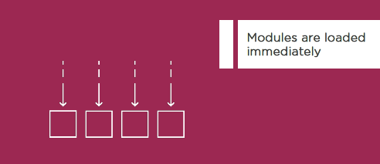
Routed Modules
  Eagerly Loading the Modules:

Slide 8
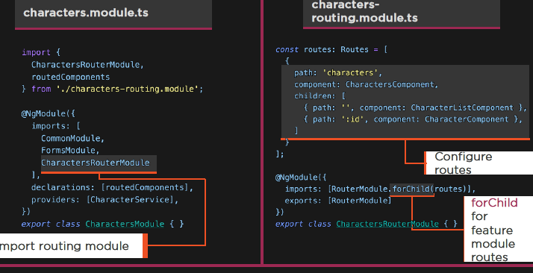
Routed Modules
  Create routing module, and import into feature module

Slide 9
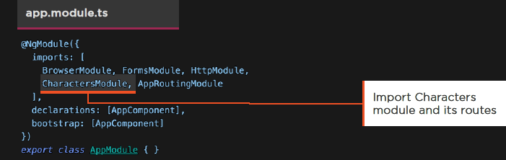
Routed Modules
  Importing Module:
  Import the CharactersModule
  We get its routes
  Order matters
  Demo: Eagerly Loading Routes

Slide 10
Routed Modules
  Lazy Loading:
  Loading modules on demand, as needed, just in time.
  Lowers the initial payload, improving the app startup experience.

Slide 11
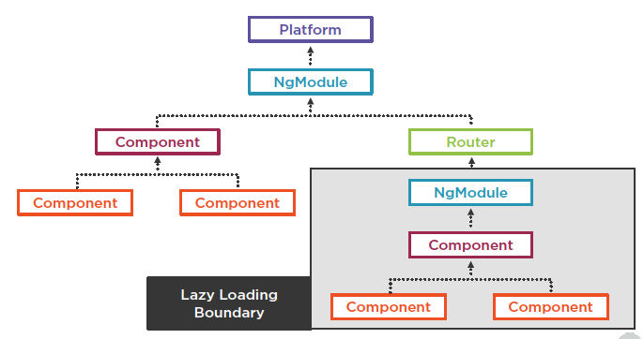
Routed Modules

Slide 12
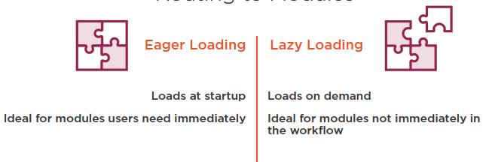
Routed Modules
  Routing to Modules:

Slide 13
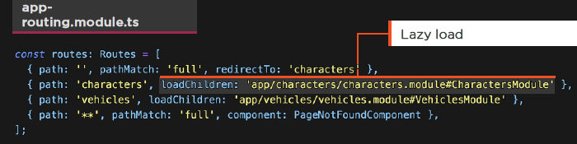
Routed Modules
  Lazy Loading:
  Use loadChildren
  Load the module by path # name
  Do not import nor reference the module directly

Slide 14
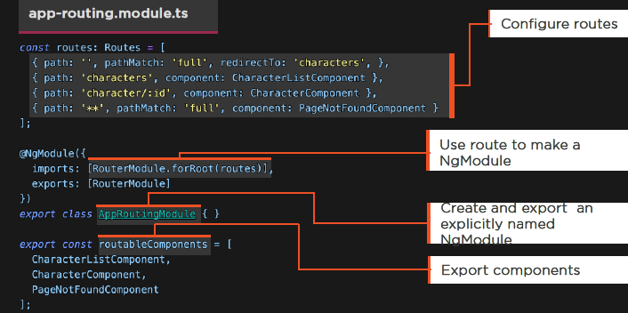
Routing Modules
  Export the Module and the Components

Slide 15
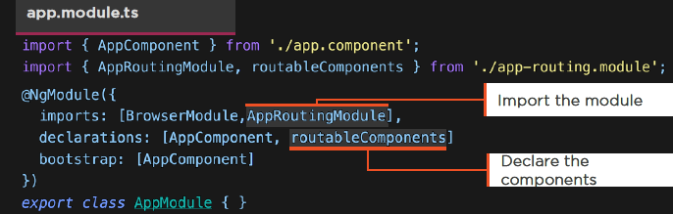
Routing Modules
  Using Our Routing Module:
  Import our routing module
  Declare the components

Slide 16
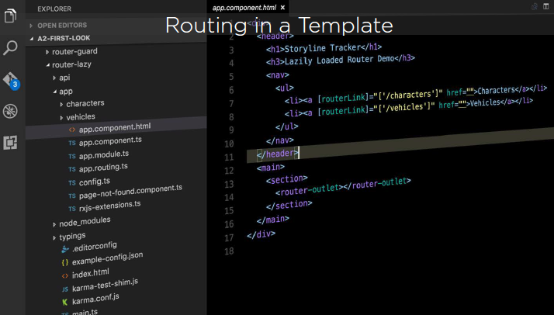
Routing Modules
  Routing in a Template:

Slide 17
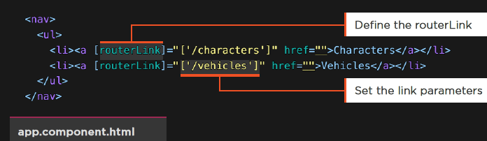
Routing Modules
  RouterLink:
  The RouterLink directive navigates to a route path
  We define the link parameters array

Slide 18
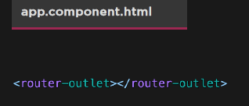
Routing Modules
  Using the RouterOutlet:
  Defines where to put the components when we route
  Demo: Need Router
  Demo: Router

Slide 19
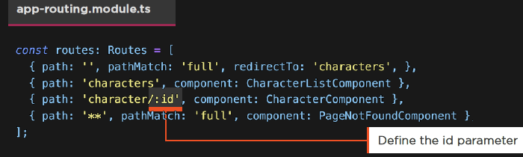
Route Parameters
  Defining Parameters:
  Indicate parameters with :id

Slide 20
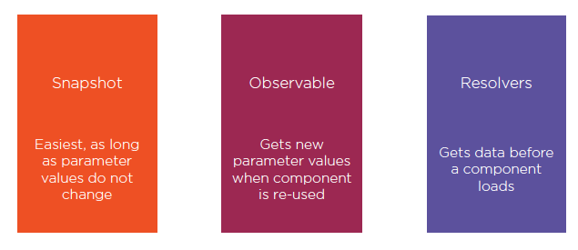
Route Parameters
  Passing Data Through Routing:

Slide 21
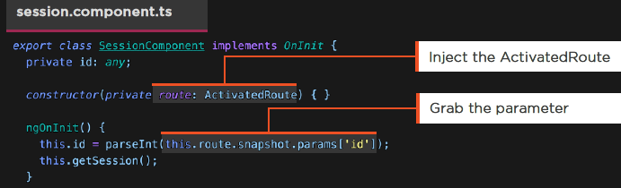
Route Parameters
  Snapshots:
  Grab the ActivatedRoute
  Access the snapshot parameter by name
  Easiest, if component is not reused

Slide 22
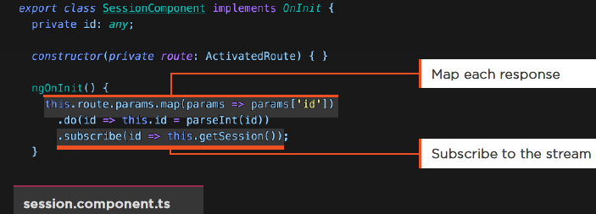
Route Parameters
  ActivatedRoute and Observables:
  Route.params is an Observable
  Map the response, perform side effects, and subscribe
  Demo: Router

Slide 23
Routing Resolvers
  Resolvers:
  Get data prior to traversing the route

Slide 24
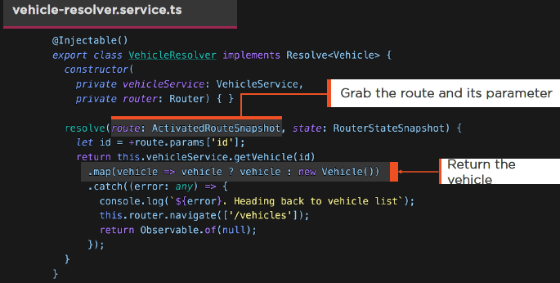
Routing Resolvers
  Service that operates in the midst of a routing action

Slide 25
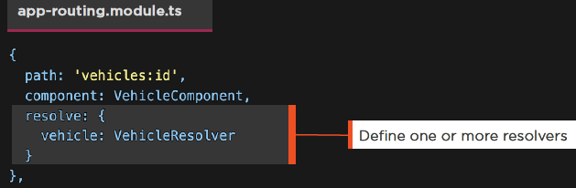
Routing Resolvers
  Resolvers:
  Defined within the route configuration
  Remember to provide the resolver service
  Demo: HTTP with Async Pipe

Slide 26
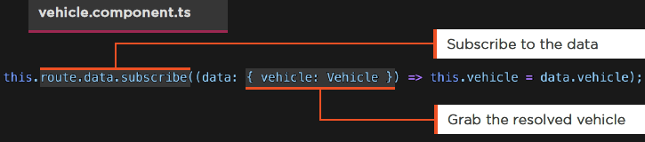
Routing Resolvers
  Getting Resolver Data:
  Subscribe to the data property on the ActivatedRoute

Slide 27
Routing Guards
  Guards:
  Guards allow us to make a decision at key points in the routing lifecycle and either continue, abort or take a new direction

Slide 28
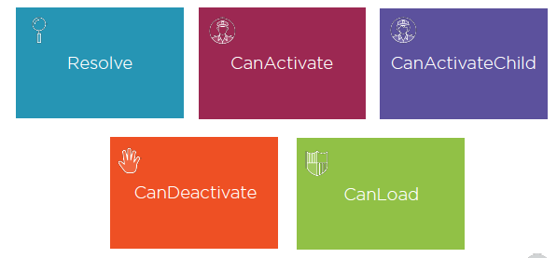
Routing Guards
  Types of Router Guards:

Slide 29
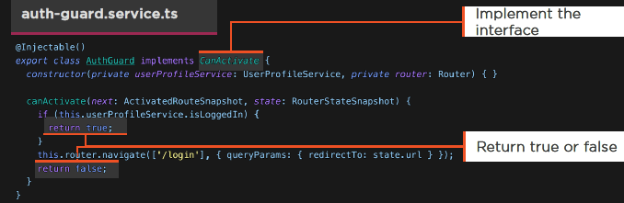
Routing Guards
  CanActivate Guard:
  Implement the CanActivate interface
  Make a determination if the route should be activated
  Can re-navigate elsewhere

Slide 30
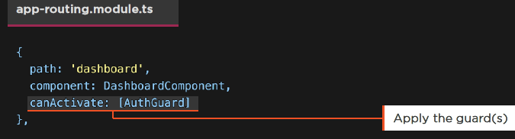
Routing Guards
  Applying a Guard:
  Apply to the route
  Demo: Routing Guards

Slide 31
Child Routes
  A Component may define routes for other Components.
  This creates a series of hierarchical child routes.

Slide 32
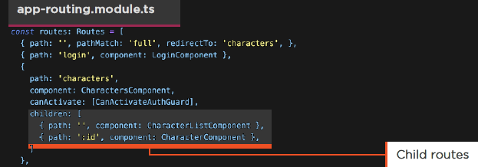
Child Routes
  Child Routes:
  URLs for parent child
  e.g. characters/ and characters/72

Slide 33
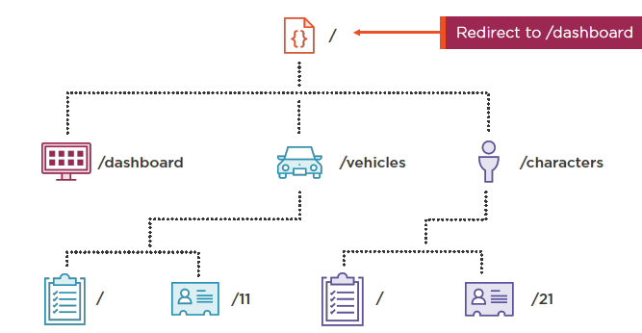
Child Routes

Slide 34
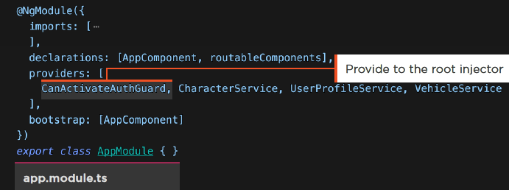
Child Routes
  Module Providers:
  Provided to the root injector
  Available everywhere

Slide 35
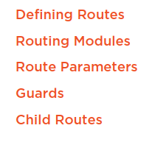
Summary

